Slide 1
Activity Diagrams and State Charts for detailed modeling
Larman, chapters 28 and 29
CSE 432: Object-Oriented Software Engineering
Glenn D. Blank

Slide 2
Goals of OO design
OO design develops the analysis into a blueprint of a solution
  Where does the “blueprint” metaphor come from?
OO design starts by fleshing the class diagrams
  Coad & Nicola call this "the continuum of representation principle: use a single underlying representation, from problem domain to OOA to OOD to OOP," i.e., class diagrams
  Reworks and adds detail to class diagrams, e.g., attribute types,
  visibility (public/private), additional constraints
  Looks for opportunities for reuse
  Addresses performance issues, both for system and users
  Designs UI, database, networking, as needed
  Designs ADT to describe the semantics of classes in more detail
  Develops unit test plans based on class diagrams and ADT design

Slide 3
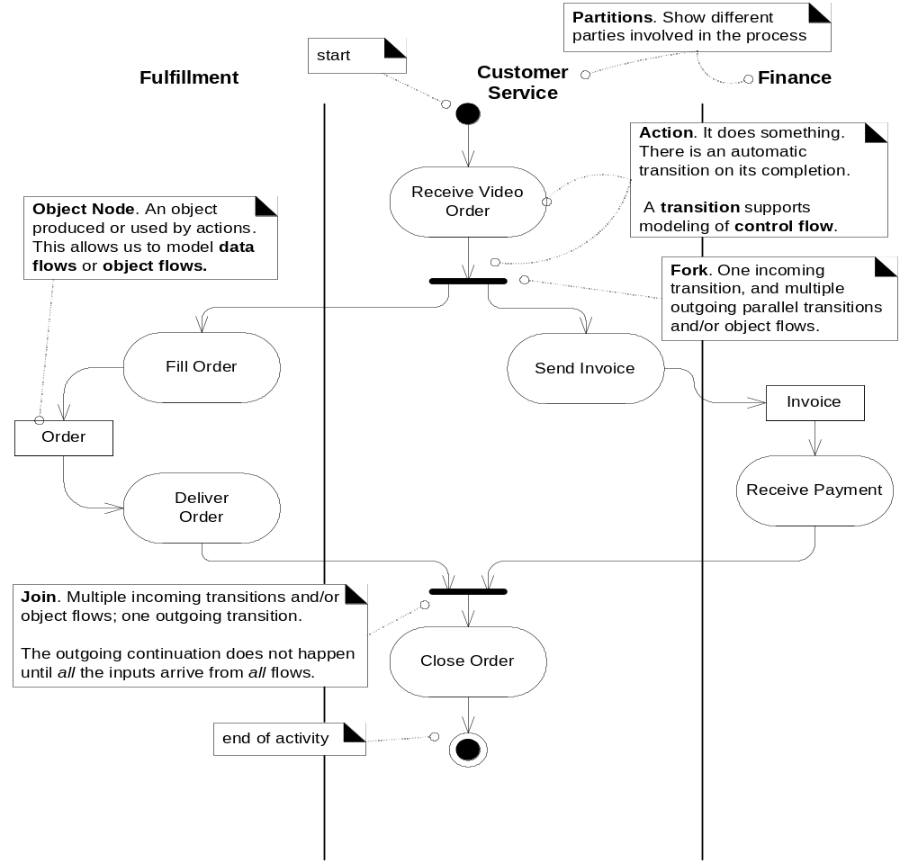
Activity Diagram - Figure 28.1
Petri nets notation
What are actions? Transitions?
How does it support parallelism?

Slide 4
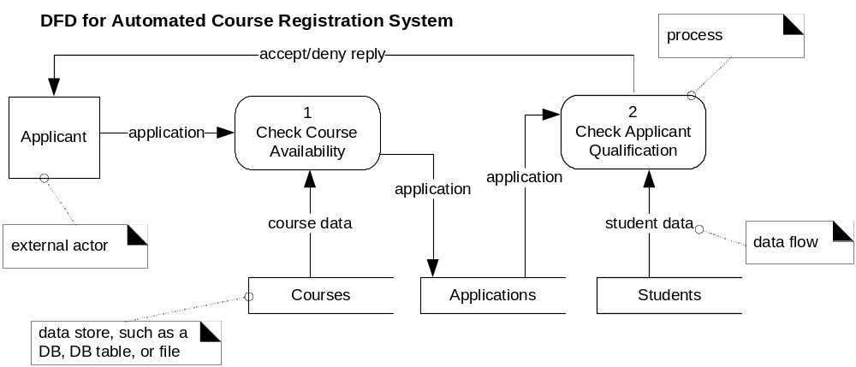
When to create Activity diagrams?
Modeling simple processes or complex ones?
Modeling business processes
  Helps visualize multiple parties and parallel actions
Modeling data flow (alternative to DVD notation)
  Visualize major steps & data in software processes

Slide 5
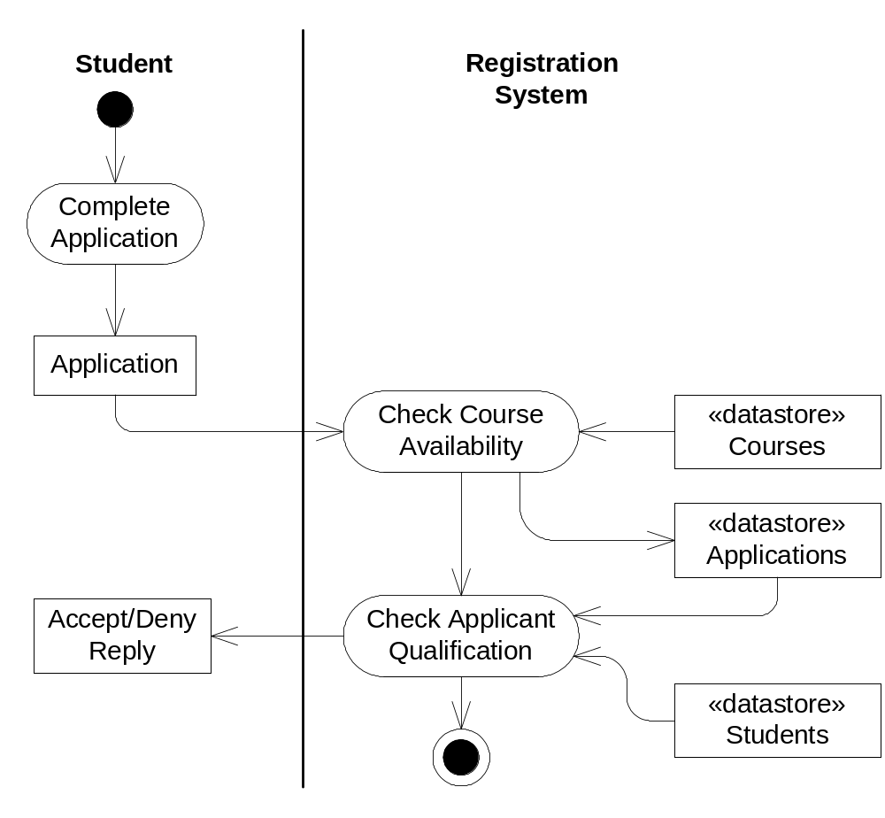
Activity diagram to show data flow model Notation pros & cons?
Figure 28.3
Figure 28.2

Slide 6
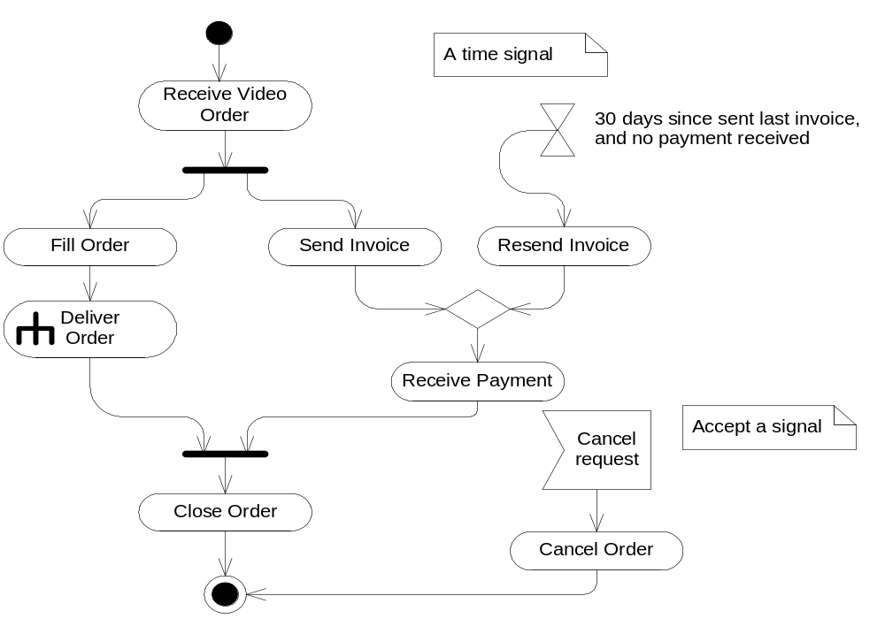
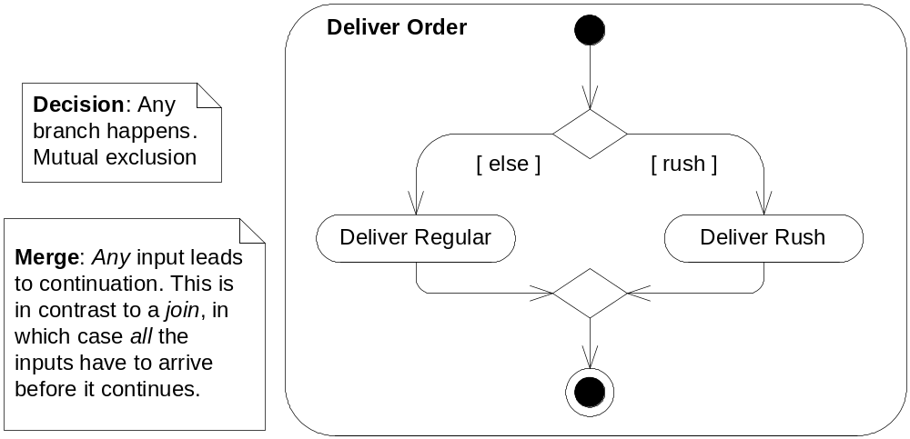
What does the Rake symbol mean?
When to use it?
Figure 28.6
Fig. 28.5

Slide 7
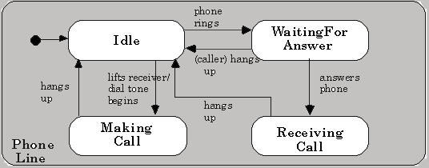
State chart Diagrams
A State chart diagram shows the lifecycle of an object
A state is a condition of an object for a particular time
An event causes a transition from one state to another state
Here is a State chart for a Phone Line object:
state
initial State
event
transition

Slide 8
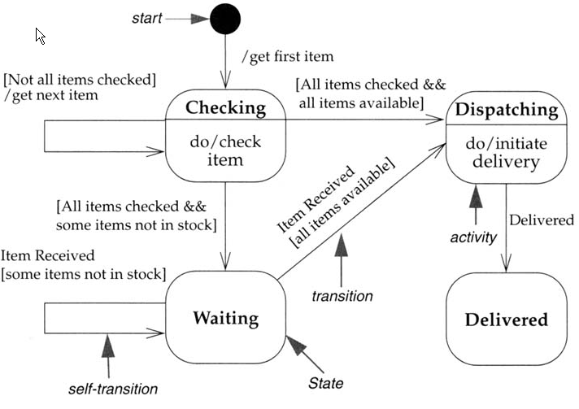
State charts in UML:
States in ovals, Transitions as arrows
Transitions labels have three optional parts:
Event [Guard] / Action
  Find one of each
  Item Received is an event, /get first item is an action, [Not all items checked] is a guard
State may also label activities, e.g., do/check item
  Actions, associated with transitions, occur quickly
  and aren’t interruptible
  Activities, associated with states, can take longer and
  are interruptible
  Definition of “quickly” depends on the kind of system,
  e.g., real-time vs. info system

Slide 9
When to develop a state chart?
Model objects that have change state in interesting ways:
Devices (microwave oven, Ipod)
Complex user interfaces (e.g., menus)
Transactions (databases, banks, etc.)
Stateful sessions (server-side objects)
Controllers for other objects
Role mutators (what role is an object playing?)
Etc.

Slide 10
Case Study: Full‑Screen Entry Systems
Straightforward data processing application: menu‑driven data entry (see overhead)
  Each menu comes with a panel of information & lets user choose next action
  Interaction during a airline reservation session
  Enquiry on flights, information & possible new states
Meyer shows different ways to solve problem
  goto flow (50's),
  functional decomposition (70's)
  OO design (90's): improves reusability and extensibility

Slide 11
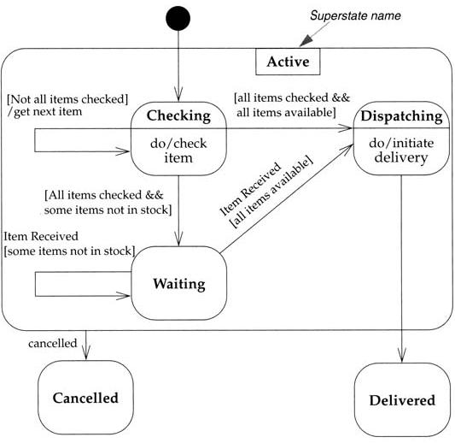
Superstates (nested states)
Example shows a super-state of three states
Can draw a single transition to and from a super-state
How does this notation make things a bit clearer?

Slide 12
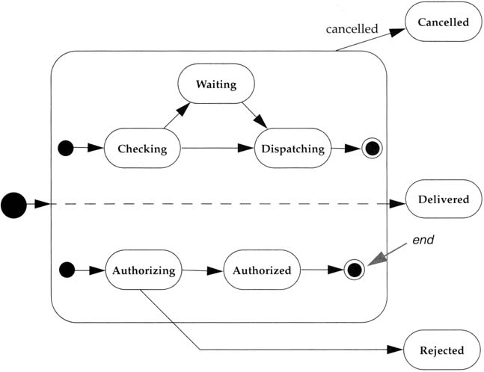
Concurrency in state diagrams
  Dashed line indicates that an order is in two different states, e.g. Checking & Authorizing
  When order leaves concurrent states, it’s in a single state: Canceled, Delivered or Rejected

Slide 13
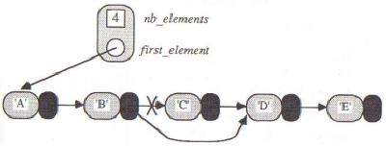
Classes as active state machines
Consider whether a class should keep track of its own internal state
  Example from Bertrand Meyer: first cut design of LINKED_LIST class
  class LINKABLE[T] ‑‑linkable cells
  feature
  value:T;
  right: LINKABLE[T]; ‑‑next cell
  ‑‑routines to change_value, change_right
  end;
  class LINKEDLIST[T]
  feature
  nb_elements: INTEGER;
  first_element: LINKABLE[T];
  value(i:INTEGER):T is ‑‑value of i‑th element; loop until it reaches the ith element
  insert(i:INTEGER; val:T); ‑‑loop until it reaches ith element, then insert val
  delete(i:INTEGER); ‑‑loop until it reaches ith element, then delete it
Problems with first‑cut?
Getting the loops right is tricky (loops are error‑prone)
Redundancy: the same loop logic recurs in all these routines
  Reuse leads to inefficiency: suppose I want a routine search
  Find an element then replace it: I'll do the loop twice!
  Need some way to keep track of the position I found!
  Could return the LINKABLE cell found, but this would ruin encapsulation

Slide 14
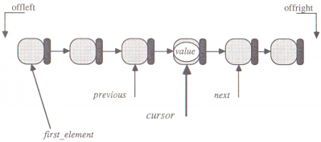
Classes as active state machines (cont.)
Instead, view LINKED_LIST as a machine with an internal state
  Internal state is information stored as attributes of an object
What have we added to represent internal state?
  Cursor: current position in the list
  search(item) routine moves the cursor until it finds item
  insert and delete operate on the element pointed at by cursor
  How does this simplify the code of insert, delete, etc.?
  Client has a new view of LINKED_LIST objects:
  l.search(item); ‑‑find item in l
  if not offright then delete end; ‑‑delete LINKABLE at cursor
  Other routines move cursor: l.back; l.forth

Slide 15
Key idea for OOD: data structures can be active
  Active structures have internal states, which change
  Routines manipulate the object's state
What other classes could be designed this way?
  Files, random number generators, tokenizers, ...
  Class as state machine view may not be obvious
  during analysis
  A good reason for redesign!

